Slide 1

Slide 1
Crimes In Chicago
Hetansh Patel

Slide 2
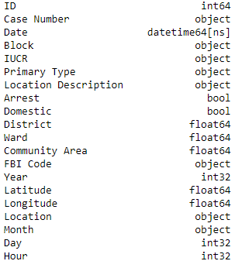
Data Types

Slide 3
Slide 2
Trend over the Years
The chart illustrates a prevailing trend in crime rates over the years, offering valuable insights into the evolution of crime patterns.
In particular, the years 2002, 2003, and 2004 exhibited significant peaks in crime rates, demonstrating a marked increase in the number of reported crimes when contrasted with adjacent years.
As of 2023, the crime rates have decreased compared to earlier years, although they are slightly higher than the levels observed in 2021.
2

Slide 4

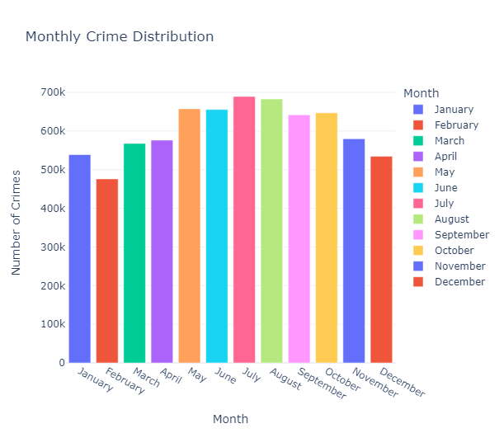
Slide 10
Monthly Distribution
February consistently exhibits the lowest number of reported crimes, while July consistently has the highest number, with almost 700,000 reported incidents. There appears to be a recurring pattern of lower crime months followed by higher crime months throughout the year. Specifically, the first four months and the last two months of the year show a significant drop in reported crimes compared to the months in between.
10

Slide 5

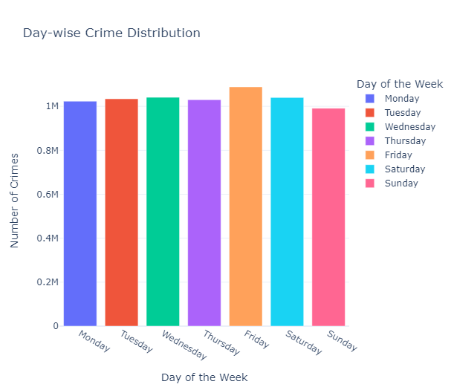
Slide 3
Day-wise Distribution
e
It's challenging to discern any significant differences in crime distribution over the days, as the pattern remains relatively consistent throughout the week. However, one noticeable trend is that Fridays consistently have the highest number of reported crimes, indicating that it's the day with the highest crime rate.
3

Slide 6
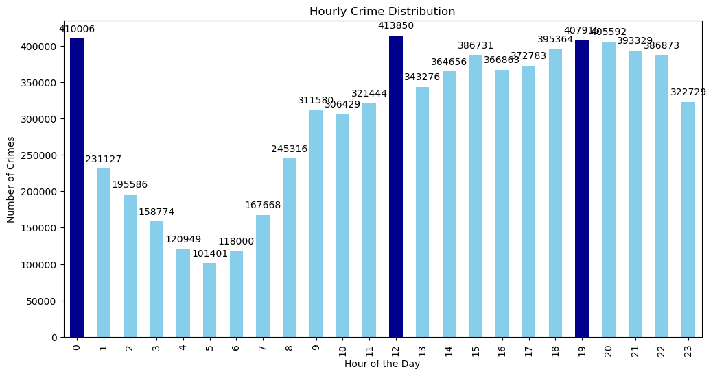
Slide 8
Hourly Distribution
The top three hours of the day, marked in dark blue, correspond to 12 A.M., 12 P.M., and 7 P.M. These hours consistently witness the highest number of reported crimes, making them the most common times for criminal incidents.
8

Slide 7
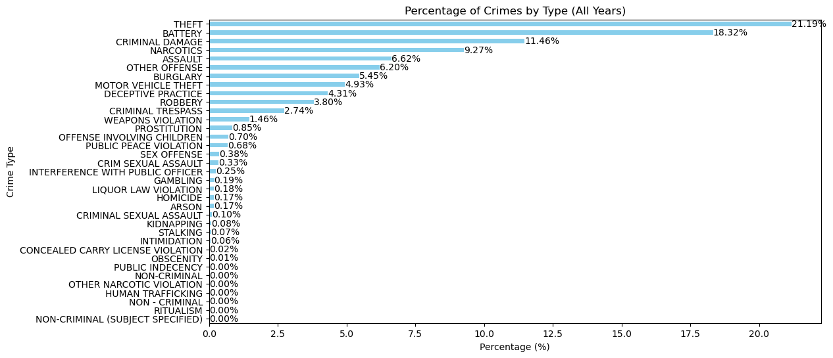
Slide 8
Crime Distribution
The analysis reveals that theft, battery, and criminal damage are the most frequently occurring types of crimes over the years. Additionally, narcotics, assault, and burglary contribute significantly to the overall crime statistics, sharing a substantial percentage among all crime types.
8

Slide 8


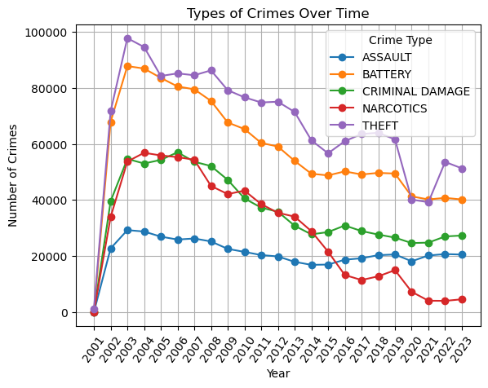
Slide 7
Theft consistently ranks as the most prevalent crime type over the years, except for 2020 and 2021, during which it closely competed with battery in terms of occurrence. The graphical representation illustrates a general decrease in various crime types, with the exception of assault, which has remained relatively consistent across each year.

Slide 9
Slide 2
Arrests Made
There appears to be a noticeable decrease in the percentage of arrests made in relation to the total number of reported crimes.
2

Slide 10
Slide 2
Crime distribution by Area
2

Slide 11
Suggestions
Data-Driven Policing: Law enforcement agencies should continue to use data analytics to identify hotspots, trends, and patterns in criminal activity.
Focused Efforts : Given Monthly and hourly patterns, police patrol and operations should be intensified during high-crime months and hours.
Review Arrest Procedures: A thorough review of arrest procedures and tactics may be necessary to improve arrest rates.
Public Awareness : Engage with the community to raise awareness about crime trends and prevention strategies.
Continuous Monitoring

Slide 12

Slide 11
THANK YOU

